Slide 1
In this chapter, the following topics will be discussed:
• Working with Constraints
• Applying Constraints
• Controlling the Display of Constraints
• Applying Dimensions
• Modifying/Editing Dimensions
• Working with Different States of a Sketch
• Working with SKETCH PALETTE

Slide 2
Working with Constraints
Constraints are used for restricting the degrees of freedom of a sketch. You can apply constraints on a sketch entity, between sketch entities, and between sketch entities and planes, axes, edges, or vertices. Some of the constraints such as horizontal, vertical, and coincident are applied automatically while drawing sketch entities.

Slide 3
Horizontal Constraint
Vertical Constraint
Coincident Constraint
Collinear Constraint
Perpendicular Constraint
Parallel Constraint
Tangent Constraint
Concentric Constraint
Equal Constraint
Midpoint Constraint
Symmetry Constraint
Curvature Constraint
Fix Constraint

Slide 4
Applying Constraints
In Fusion 360, you can apply constraints by using the constraints tools available in the CONSTRAINTS panel of the SKETCH contextual tab in the Toolbar.

Slide 5
For example, to apply a concentric constraint between an arc and a circle, click on the Concentric tool in the CONSTRAINTS panel. Next, click on the arc and then the circle in the drawing area one by one.
TIP: Most of the time, the second selected entity moves to fulfil the applied constraint condition. However, sometimes due to the other applied constraints, the first selected entity moves to fulfil the constraint condition.

Slide 7
TIP: You can also apply a constraint between the selected entities by using the Marking Menu.

Slide 8
Controlling the Display of Constraints
You can control the visibility of the applied constraints in the drawing area.
NOTE: You can also delete an already applied constraint by selecting it in the drawing area and then pressing the DELETE key.

Slide 9
Applying Dimensions
Once a sketch has been drawn and the required geometric constraints have been applied, you need to apply the required dimensions to the sketch.
The Sketch Dimension tool is used for applying dimensions, depending upon the type of entity selected.

Slide 10
Applying a Horizontal Dimension
TIP: After selecting an inclined entity or two sketch points, if you move the cursor in a direction other than vertically up or down, then notice that the vertical or aligned dimension gets attached to the cursor.

Slide 11
Applying a Vertical Dimension
Applying an Aligned Dimension

Slide 12
Applying an Angular Dimension

Slide 13
Applying a Diameter Dimension
NOTE: By default, the diameter dimension is applied to a circle. However, you can also apply a radius dimension to a circle.

Slide 14
Applying a Radius Dimension
NOTE: By default, the radius dimension is applied to an arc. However, you can also apply the diameter dimension to an arc.

Slide 15
Applying a Linear Diameter Dimension
NOTE: If a centerline is selected as the revolving axis of the sketch, then on selecting the second linear sketch entity, the linear diameter dimension gets automatically attached to the cursor.

Slide 16
Modifying/Editing Dimensions
After applying dimensions, you may need to modify them due to changes in the design, revisions in the design, and so on.

Slide 17
Working with Different States of a Sketch
In Fusion 360, a sketch can be either under defined or fully defined.
Under Defined Sketch
Fully Defined Sketch

Slide 18
NOTE: When you apply a dimension to a fully defined sketch, the Over-constrained sketch message window appears, informing you that adding this dimension would over-constrain the sketch and suggests applying it as the driven dimension.

Slide 19
Working with SKETCH PALETTE
The SKETCH PALETTE dialog box appears every time a sketch is active.

Slide 20
Look At
Slice
Show Profile

Slide 21
Show Points
Show Dimensions
Show Constraints
Show Projected Geometries
3D Sketch
On selecting the 3D Sketch check box, you can create a 3D sketch by using the sketching tools such as Line and Spline.

Slide 22
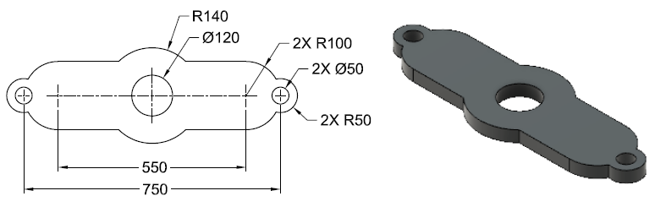
Tutorial 1
Draw the sketch shown in the figure and make it fully defined by applying all dimensions and constraints. The model shown in this figure is for your reference only. All dimensions are in mm.
To create this tutorial, follow the steps given in the textbook.

Slide 23
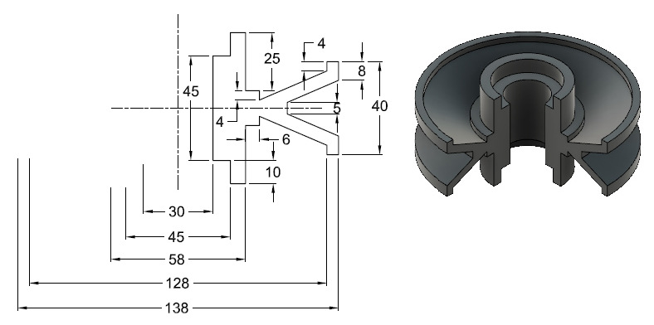
Tutorial 2
Draw the sketch shown in the figure and make it fully defined by applying the dimensions and constraints. The model shown in this figure is for your reference only. All dimensions are in mm.
To create this tutorial, follow the steps given in the textbook.

Slide 24
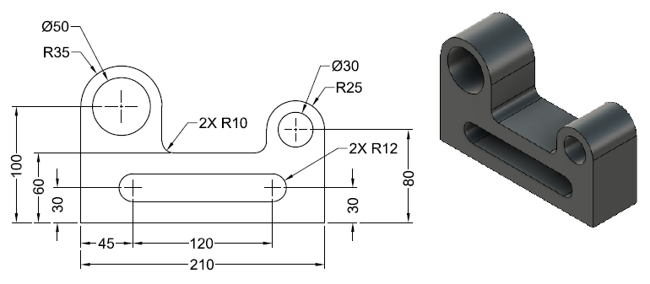
Tutorial 3
Draw the sketch shown in the figure and make it fully defined by applying all dimensions and constraints. The model shown in this figure is for your reference only. All dimensions are in mm.
To create this tutorial, follow the steps given in the textbook.

Slide 25
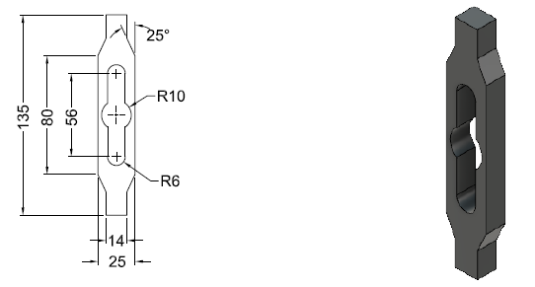
Hands-on Test Drive 1
Draw a sketch of the model shown in the figure. You need to apply constraints and dimensions to make it fully defined. The model shown in the figure is for your reference only. All dimensions are in mm.

Slide 26
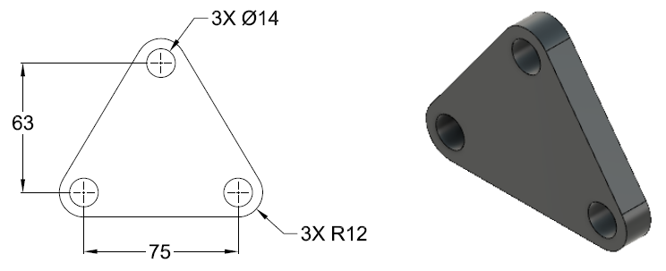
Hands-on Test Drive 2
Draw a sketch of the model shown in the figure. You need to apply dimensions to make it fully defined. The model shown in the figure is for your reference only. All dimensions are in mm.

Slide 27
Summary
This chapter introduced the concept of fully defined sketches encompassing the application of constraints and dimensions. Various types of constraints and methods for application of constraints and dimensions to sketch entities were discussed, in addition to the methods for controlling the display of applied constraints and modifying or editing the dimensions of sketch entities. The chapter also introduced the different states of a sketch and various tools of the SKETCH PALETTE dialog box.

Slide 28
Questions
The ________ constraint is used for coinciding a sketch point on to a line, an arc, or an elliptical entity.
You can control the display or visibility of the applied constraints by using the ________ check box of the SKETCH PALETTE dialog box.
The ________ dimension is applied to a sketch representing revolve features.
All degrees of freedom of a ______ sketch are fixed.
You can apply constraints by using the constraints tools available in the ______ panel of the SKETCH contextual tab.
The ______ tool is used for applying dimension, depending upon the type of entity selected.

Slide 29
The ______ tool is used for changing the orientation of the sketching plane normal to the viewing direction.
The ______ check box of the SKETCH PALETTE dialog box is used for cutting the object by using the sketching plane of the sketch.
You cannot modify the dimensions once they have been applied. (True/False)
You cannot delete the constraints that have already been applied between the selected entities. (True/False)
Constraints are used for restricting some degrees of freedom of a sketch. (True/False)

